Slide 1

Bacchus Winery Case Study
Alisa Steensen, Jose Franco, Usiel Figueroa, Carmen Mendoza

Slide 2

AGENDA
Group INTRODUCTION
Case study overview
Finalized erd
reports
Assumptions & design Decisions
Conclusion

Slide 3

Meet the team

Slide 4

The Team
Alisa Steensen: Lead Analyst - Played a pivotal role in gathering detailed business requirements and ensuring that the project goals were clearly defined and aligned with Bacchus Winery's operational objectives.
Usiel Figueroa: Database Designer – Expertly designed the ERD and database schema, ensuring normalization and establishing efficient relationships between entities.
Jose Franco: Query Specialist – Developed comprehensive SQL queries to retrieve and analyze critical data, facilitating insightful reporting for business decisions.
Carmen Mendoza: Report Specialist - Focuses on interpreting query results and creating visually engaging report templates that communicate key findings.

Slide 5

Case study Overview
Objective: Transition from manual processes to a digital database system for efficiency.
Business Rules:
Monitor supplier delivery times and inventory monthly.
Track employee work hours and generate quarterly reports.
Evaluate win distribution performance using monthly sales data.
Create annual comprehensive reports identifying gaps.
Assumptions:
Existing processes are manual.
Investment in online platforms is planned.
Distributors provide detailed sales data.

Slide 6
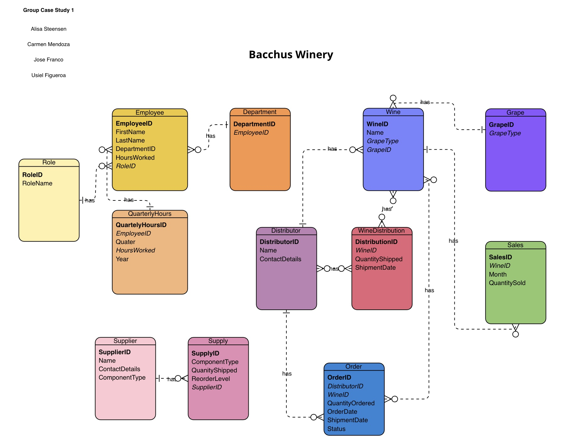
Finalized eRD
•Employees are assigned to departments, and each department has a manager. Many to One, One to One
•The winery produces four types of wines, which are distributed by distributors. (Many wines to many distributers) Many to Many
•Distributors carry one or more wines, and wines can be carried by multiple distributors. Many to Many
•Suppliers provide specific supplies to the winery, tracked by type. One to Many

Slide 7

Reports generated
Supplier Delivery Performance Report: Identifies delayed deliveries and supplier gaps.
Monthly Delivery Gaps Report: Compares delays and total orders for each supplier by month.
Wine Sales Performance Report: Tracks total quantities shipped and sold by wine and distributors.
Employee Hours Report: Summarizes hours worked in the last four quarters

Slide 8
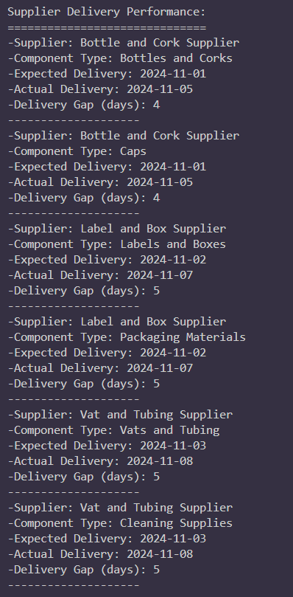
Supplier Reports

Slide 9
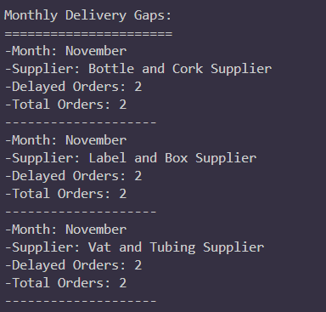
Monthly Delivery gaps report

Slide 10
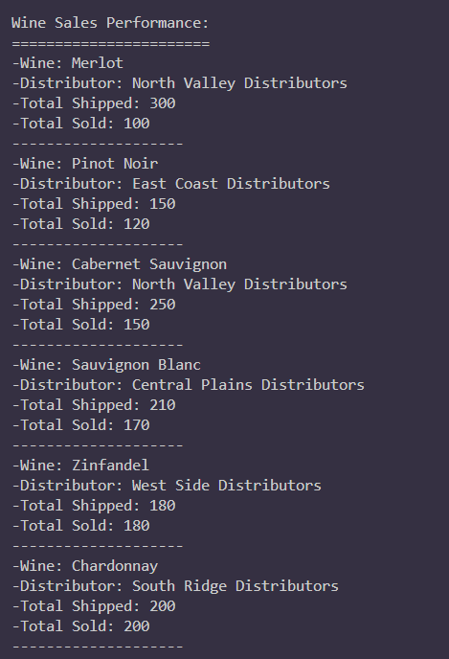
Wine Sales Report

Slide 11
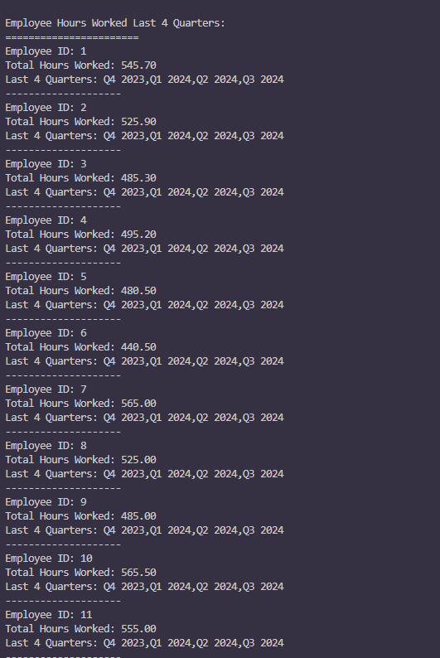
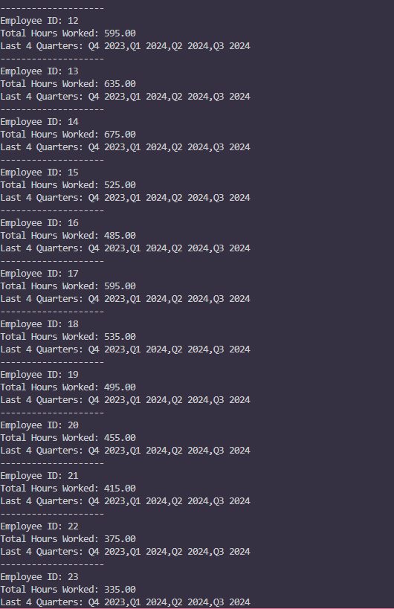
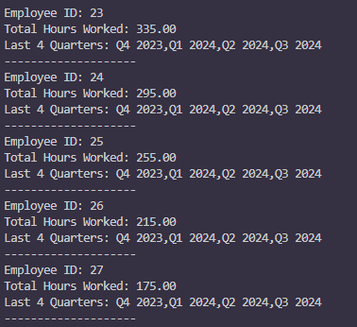
Employee Hours Report

Slide 12
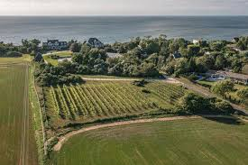
Assumptions & Design Decisions
Assumptions:
Transition from manual to digital systems with investment in online platforms.
Suppliers and distributors provide detailed data for tracking.
Design Decisions:
The focus is on automating key business processes.
Enabling comprehensive reporting for management insights.

Slide 13
COnclusion
The designed database system aligns with Bacchus Winery's operational needs and addresses inefficiencies in supply chain management, employee hour tracking, and wine distribution analysis.
Reports provide actionable insights for better decision making, such as identifying delayed suppliers, improving wine sales strategies, and evaluating employee productivity.
Improved operational efficiency through automation of manual processes.
Real-time tracking and reporting to enable proactive issue resolution.
A scalable solution that can grow with the business as new requirements emerge.
Seek feedback
Reflect on performance
Explore new techniques
Set personal goals
Iterate and adapt

Slide 14

THANK YOU
Alisa Steensen
Jose Franco
Usiel Figueroa
Carmen Mendoza

